Slide 1

Cyclistic Bike Analysis

Slide 2
Purpose of the Analysis
Uncover trends of our current customer base
Understand the difference between the two member groups
Provide marketing strategies to promote current casual riders to annual membership.

Slide 3
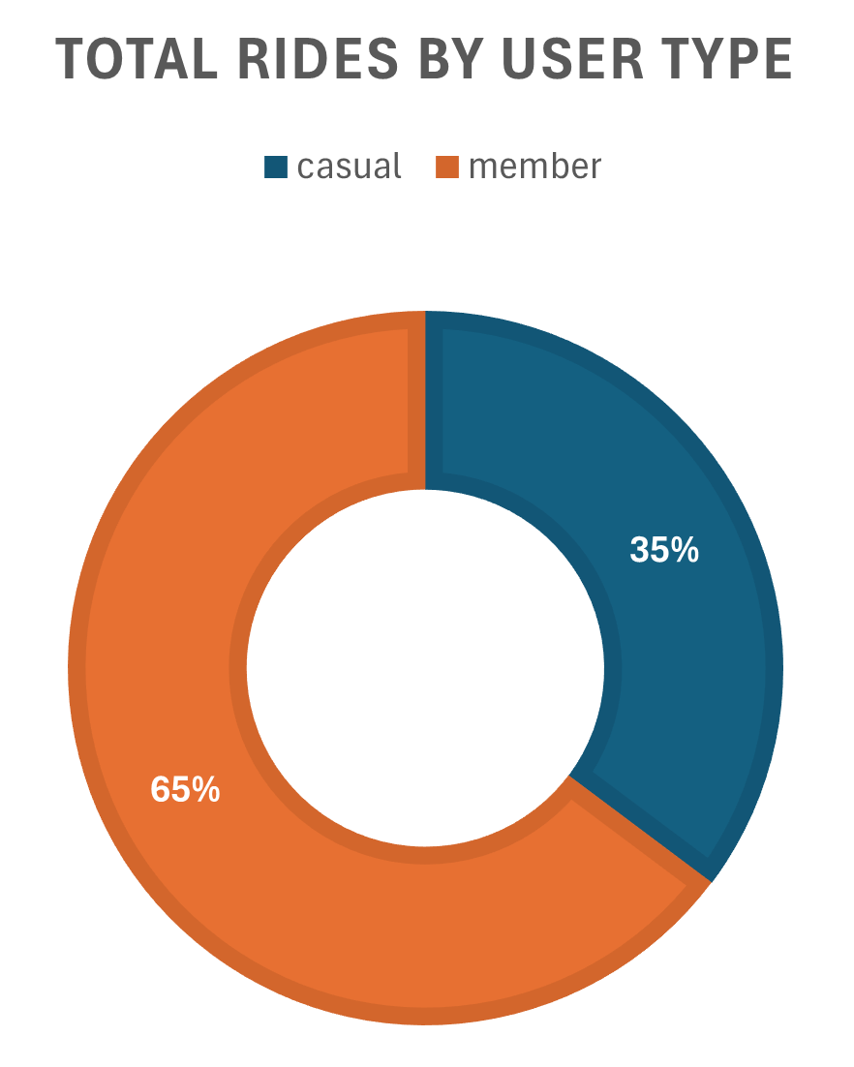
Total Rides and Average Duration
Initial observation count: 5,699,639
Final ride count: 4,091,950
Member rides: 2,650,101 (12 min avg duration)
Casual rides: 1,441,849 (23 min avg duration)

Slide 4
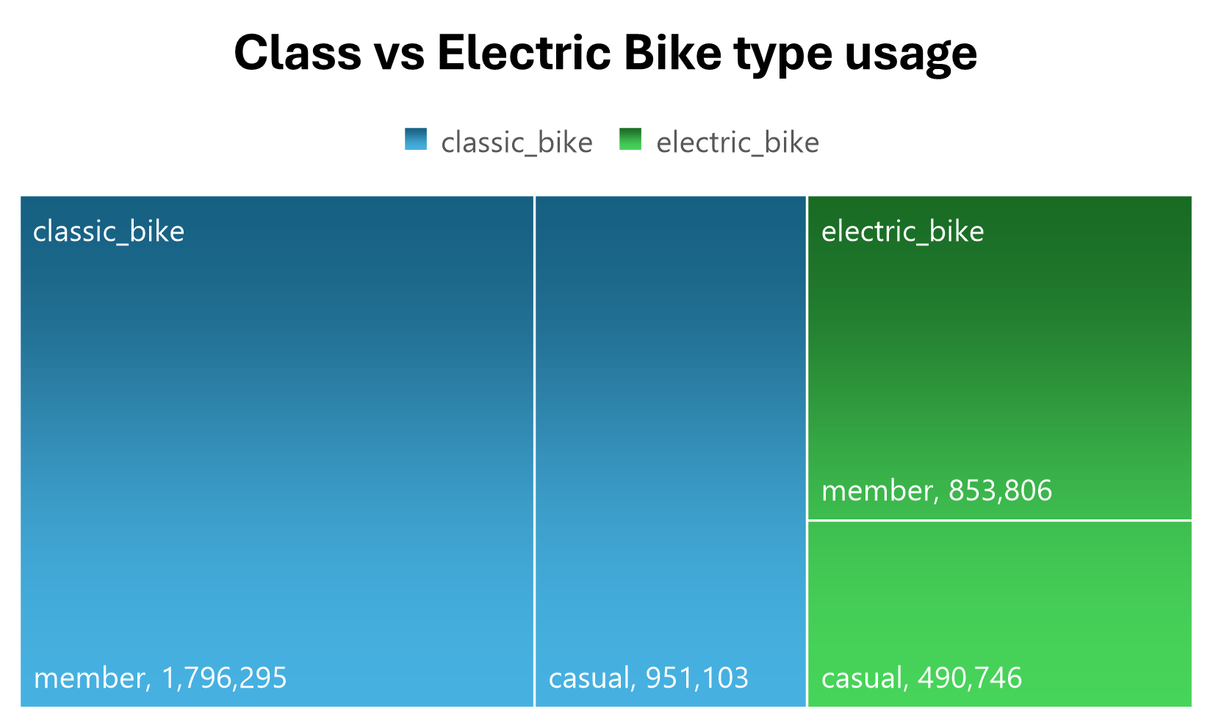
Bike option preference
Classic Bikes: 67% total rides
Casual: 35%
Member: 65%
Electric Bikes: 33% total rides
Casual: 36%
Member: 64%

Slide 5
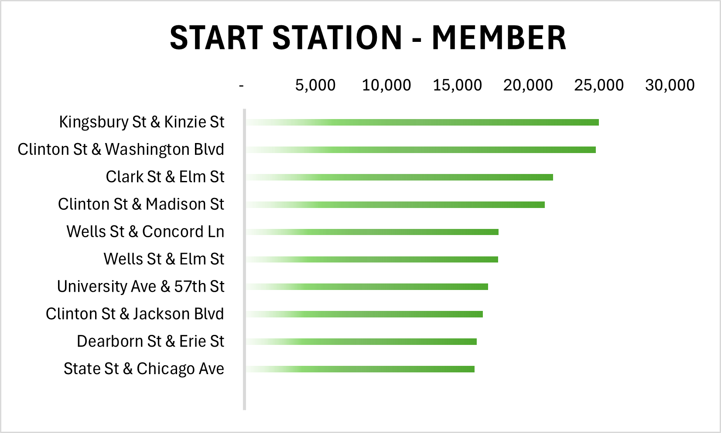
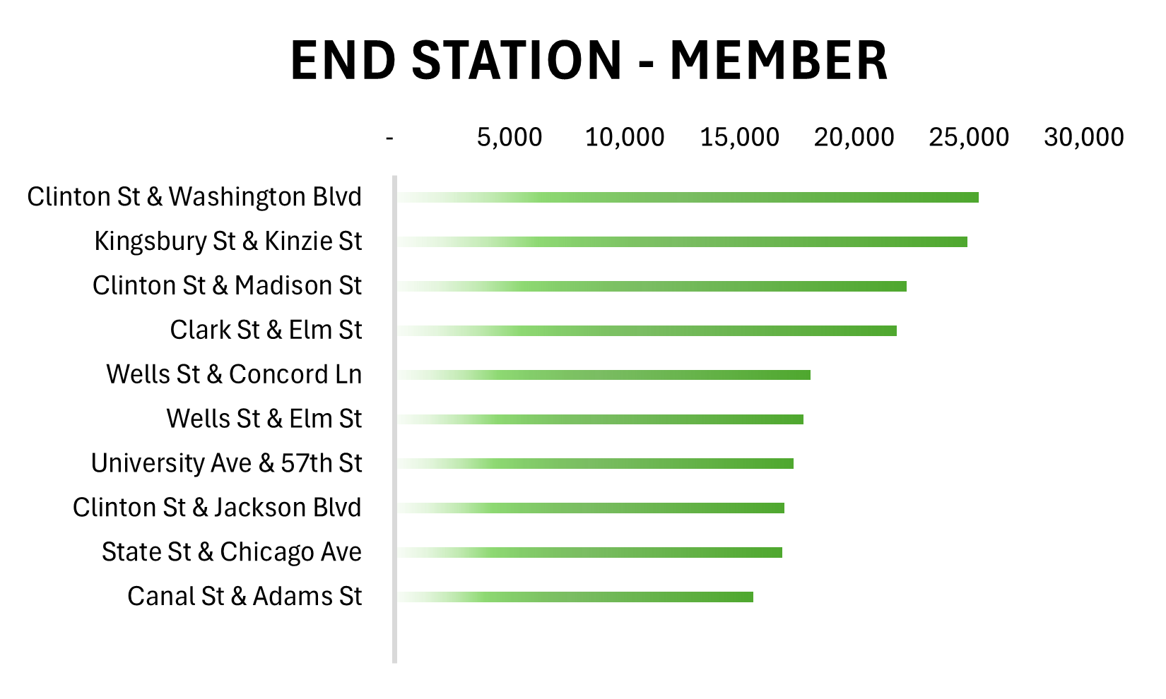
Top Ten - Member

Slide 6
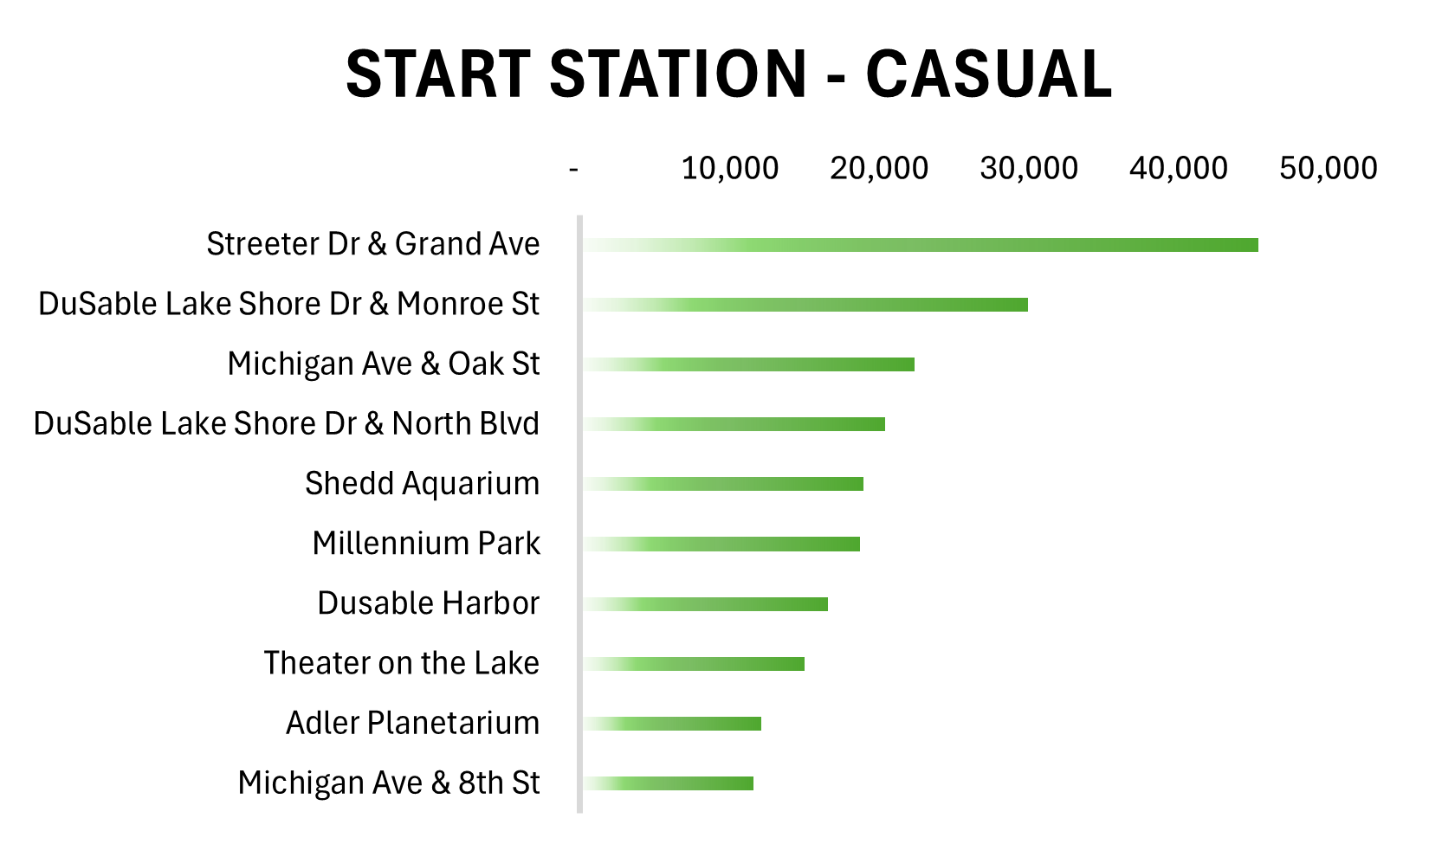
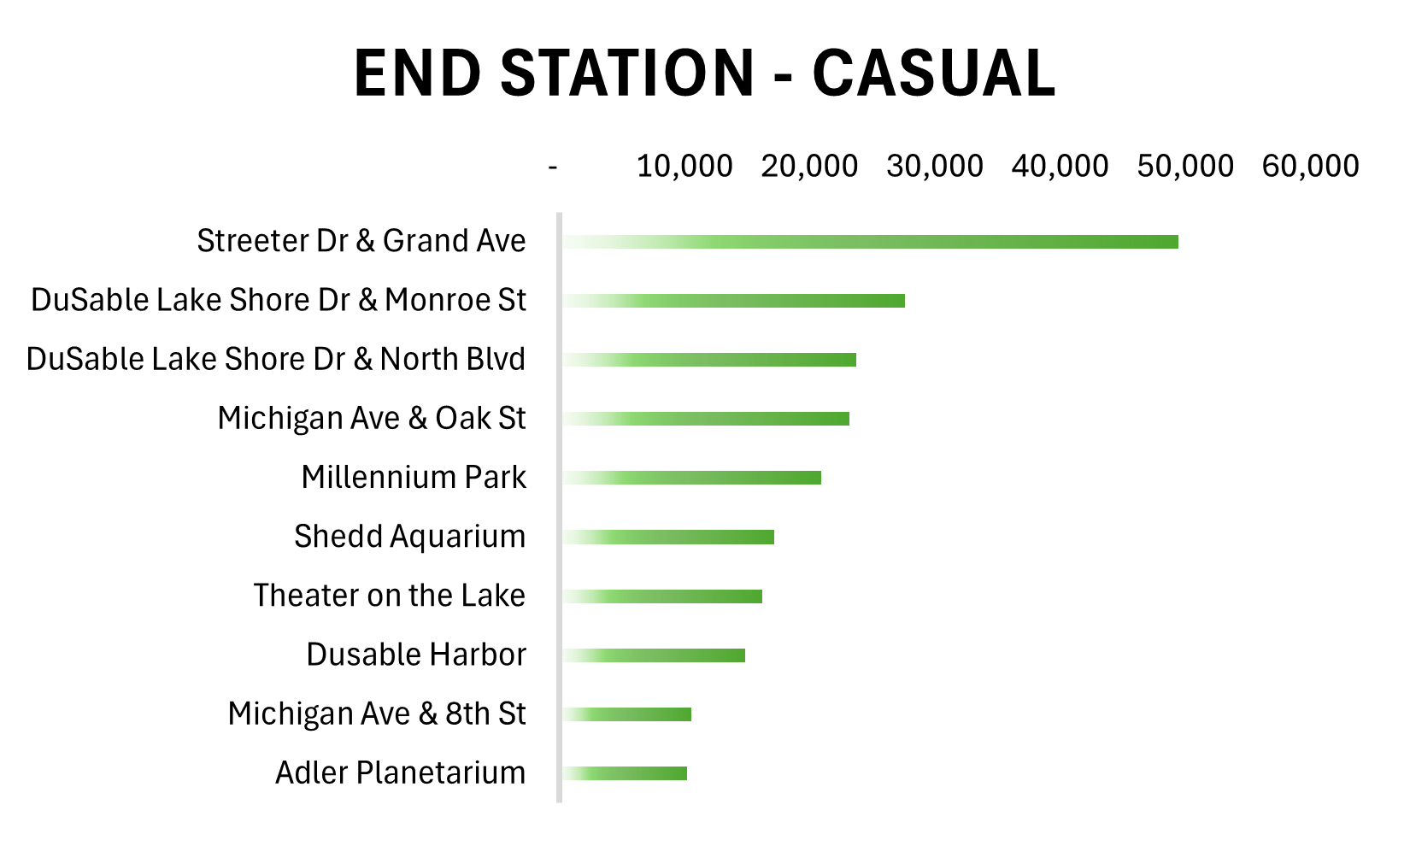
Top Ten - Casual

Slide 7
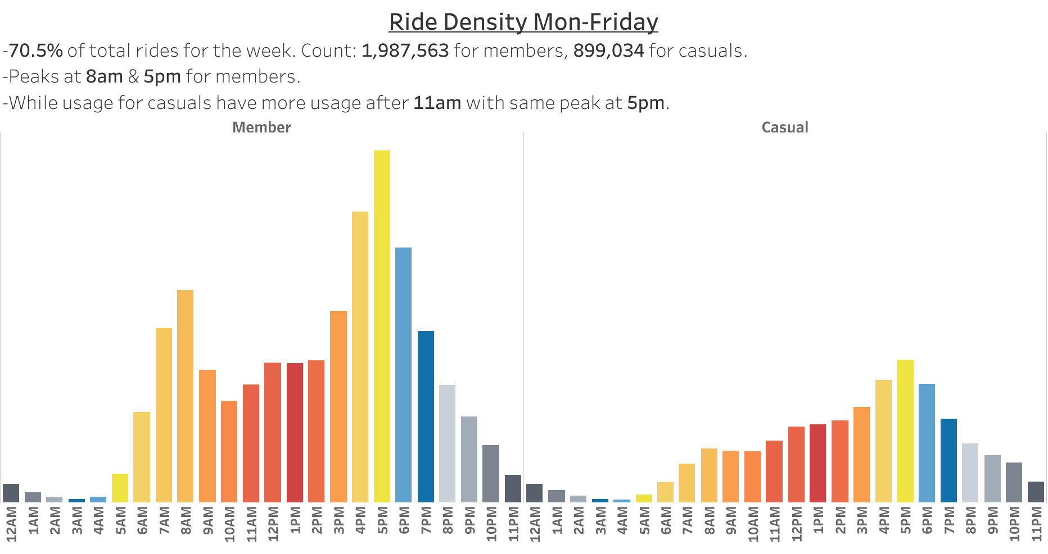

Slide 8
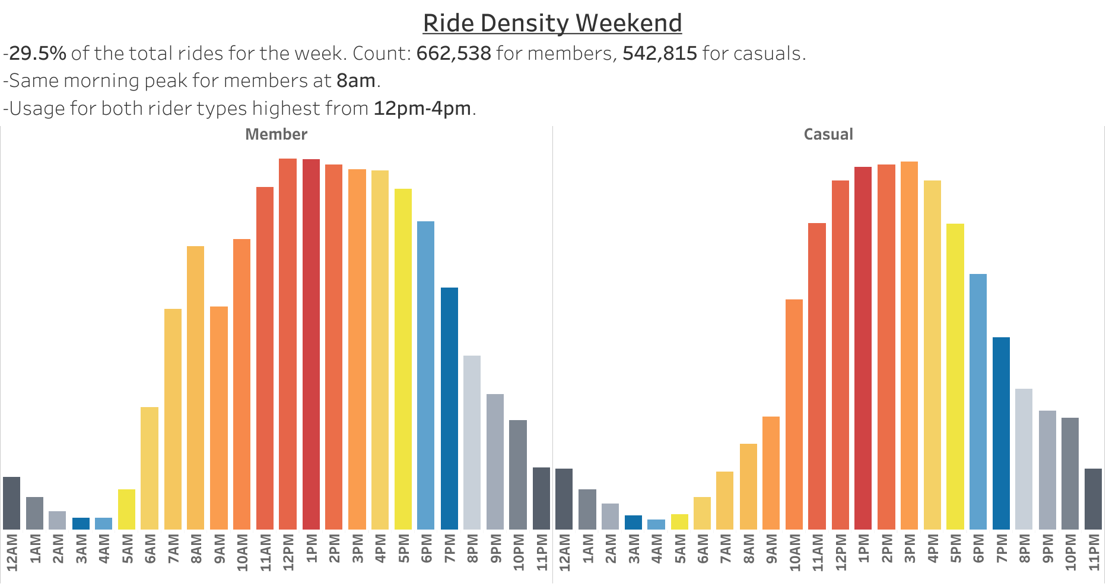

Slide 9
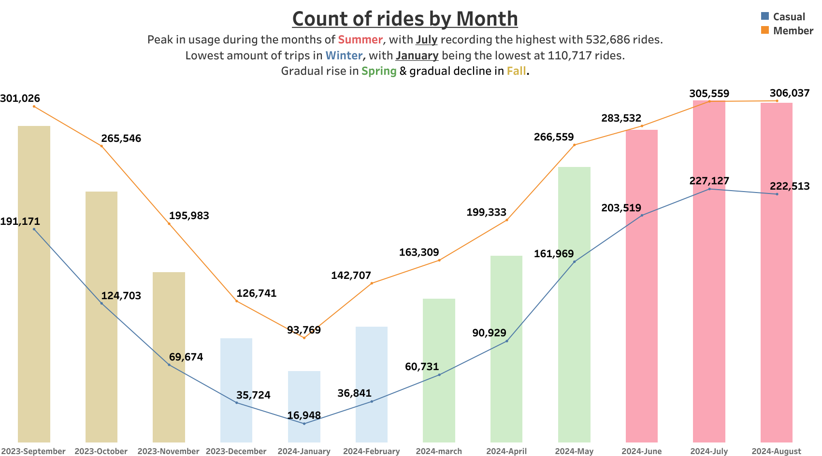

Slide 10
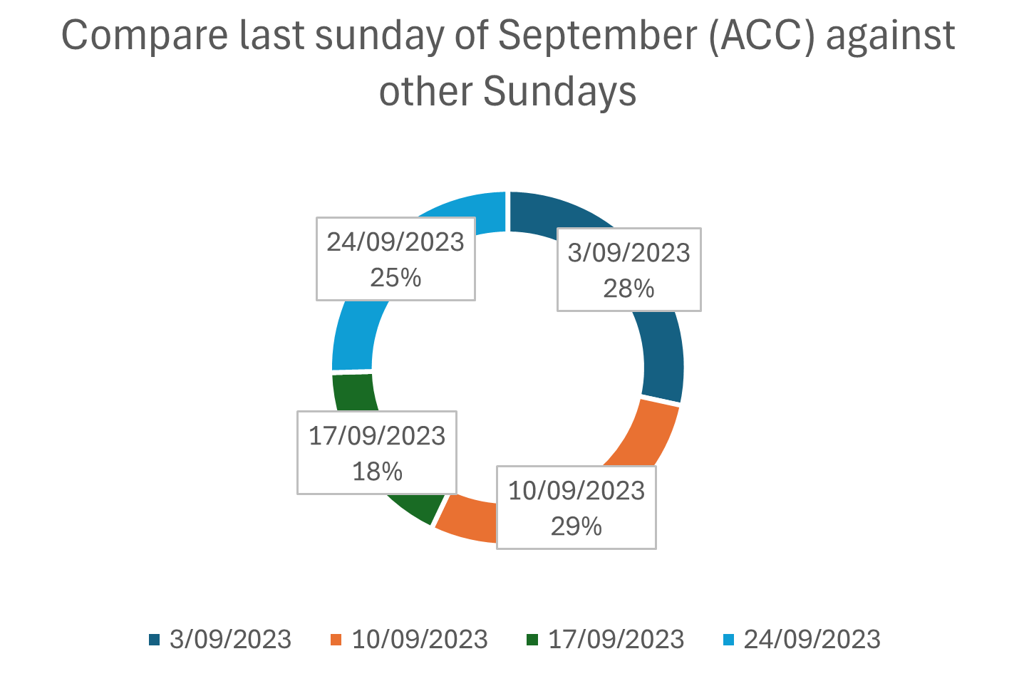
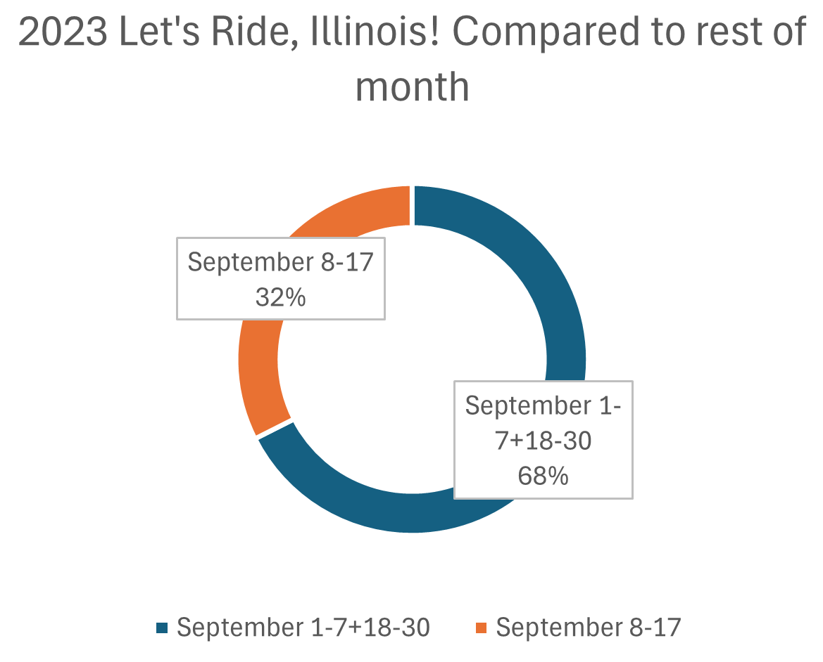
Special Events Impact

